Slide 1

Project OPI
TEAM
QUANTUM
Problem Statement ID – 1658
Problem Statement Title- Development of a versatile and fast algorithm for the optimal ship routing
Theme- Transportation & Logistics
PS Category- Software.
Team ID -
Team Name – TEAM QUANTUM
Department - Indian National Center for Ocean Information Services (INCOIS)

Slide 2
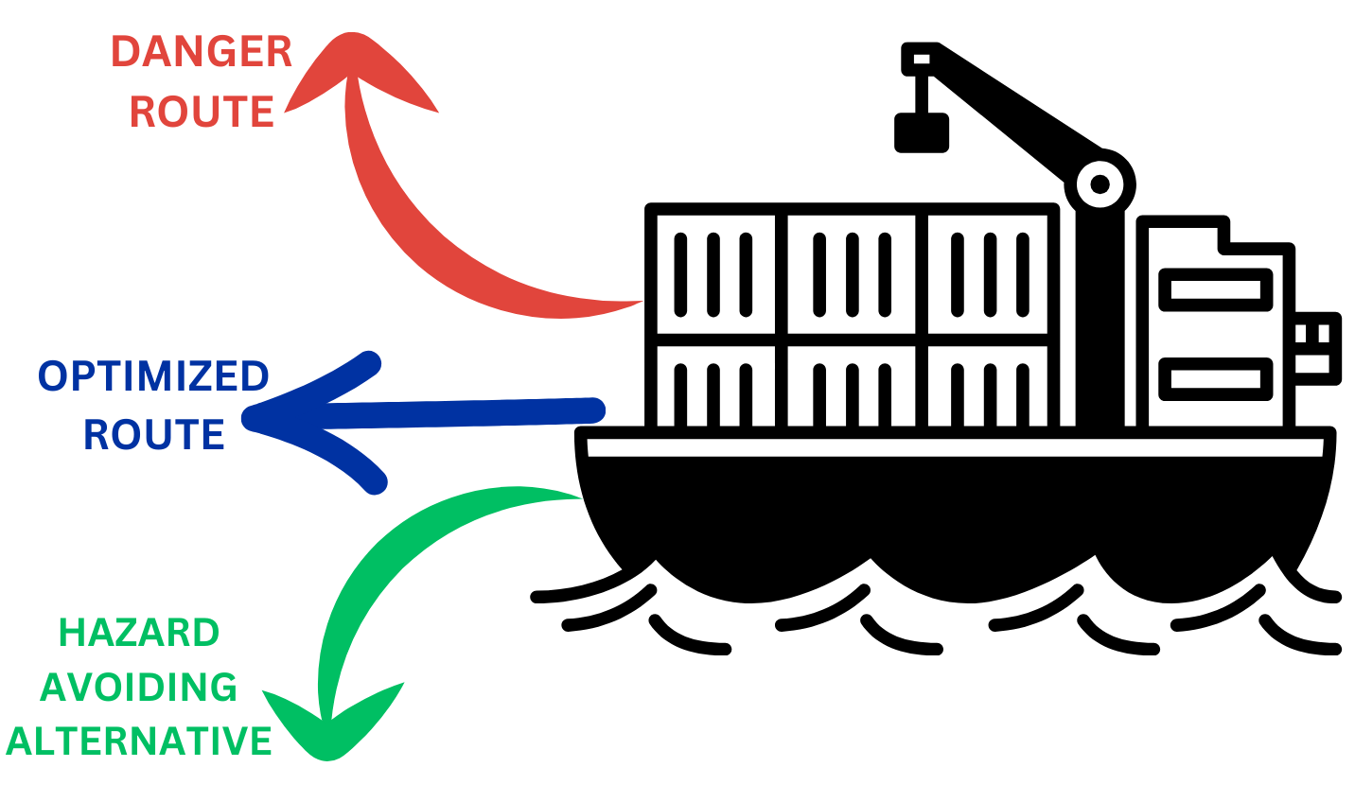
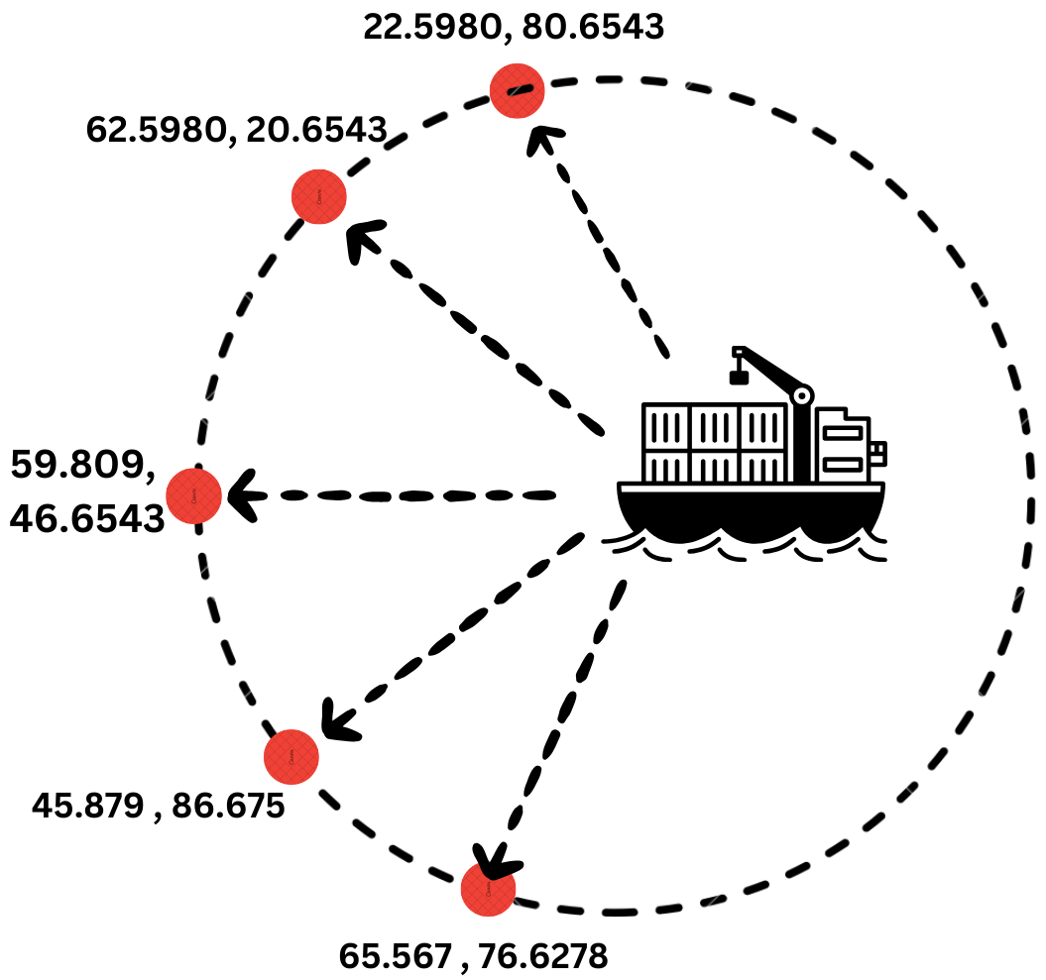
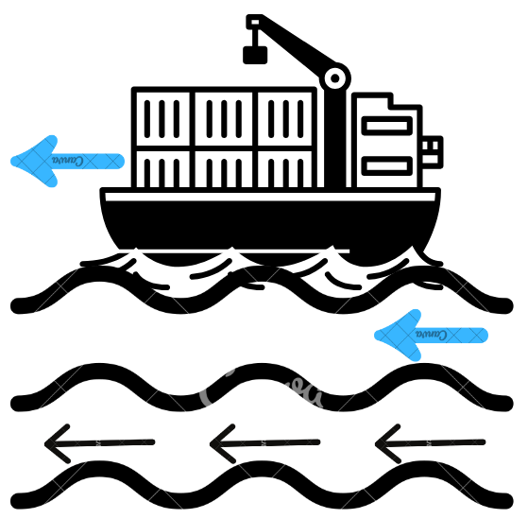
Ideal Route Solution
TEAM
QUANTUM
Problem Addressed : Adaptive routing with real-time data integration route.
Optimization Algorithm: Multi-parameter optimization for fuel efficiency, travel time, comfort, and safety.
Route Optimization
Center of Reference
Current-Driven
A dangerous route (red), an optimized route (blue), and a hazard-avoiding alternative (green), highlighting different path options based on safety and efficiency.
Calculating the whether from latitude and longitude of points on a circumference with the ship as the central reference point.
Providing a route where the ship navigates with the natural flow of ocean currents, ensuring optimal alignment

Slide 3
Major Tech Stack Being Used
TEAM
QUANTUM

Slide 4


TEAM
QUANTUM
Feasibility and Viability
Fuel Efficiency Optimized Routes : Using favorable currents reduces fuel consumption and lowers costs.
Increased Speed Currents Boost : Favorable currents increase speed, improving delivery times and operational efficiency.
Real-Time Adjustments : Advanced navigation tools use weather forecasts and ocean currents to optimize routes, enhancing speed and fuel efficiency.
Historical Data : Analyzing past routes helps identify the most efficient path between ports for optimal journeys.

Slide 5
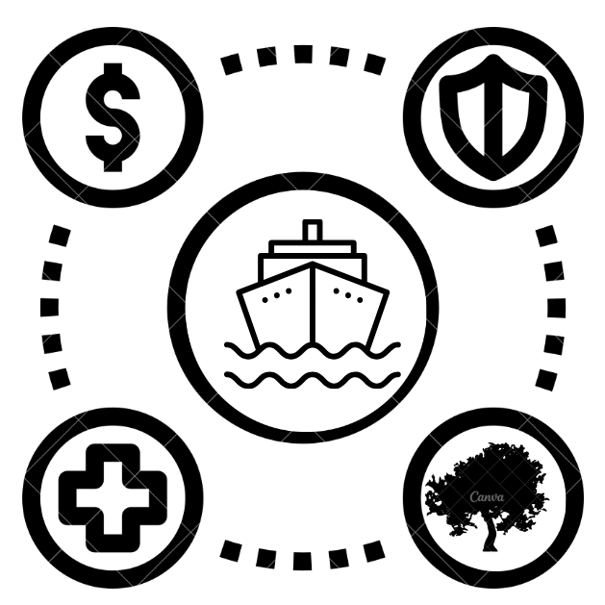
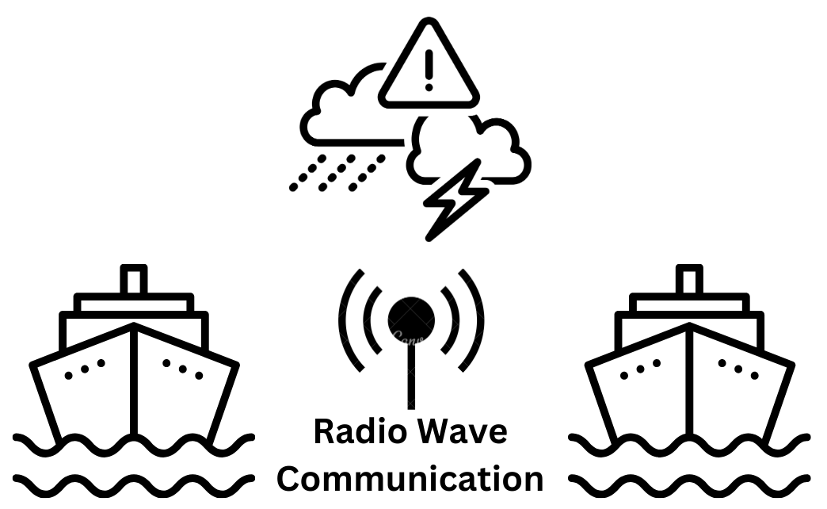
IMPACT AND BENEFITS
TEAM
QUANTUM
Potential impact on target audience
Environmental Agencies :
Optimized routes to reduce environmental impact and emissions.
Shipping Companies :
Efficient routing cuts fuel costs, lowers expenses, and improves scheduling.
Insurance Companies : Better route lowers the risk of accidents and losses.
Benefits of our solution
Fuel Saving : Optimizes routes to cut fuel and emissions.
Reduced Emission : Optimizes routes to cut fuel and emissions.
Increased Efficiency: Improves resource use and saves time.
Competitive Edge : Gives a strategic advantage in shipping.
Radio Protocols : Ensures smooth ship-port communication.

Slide 6
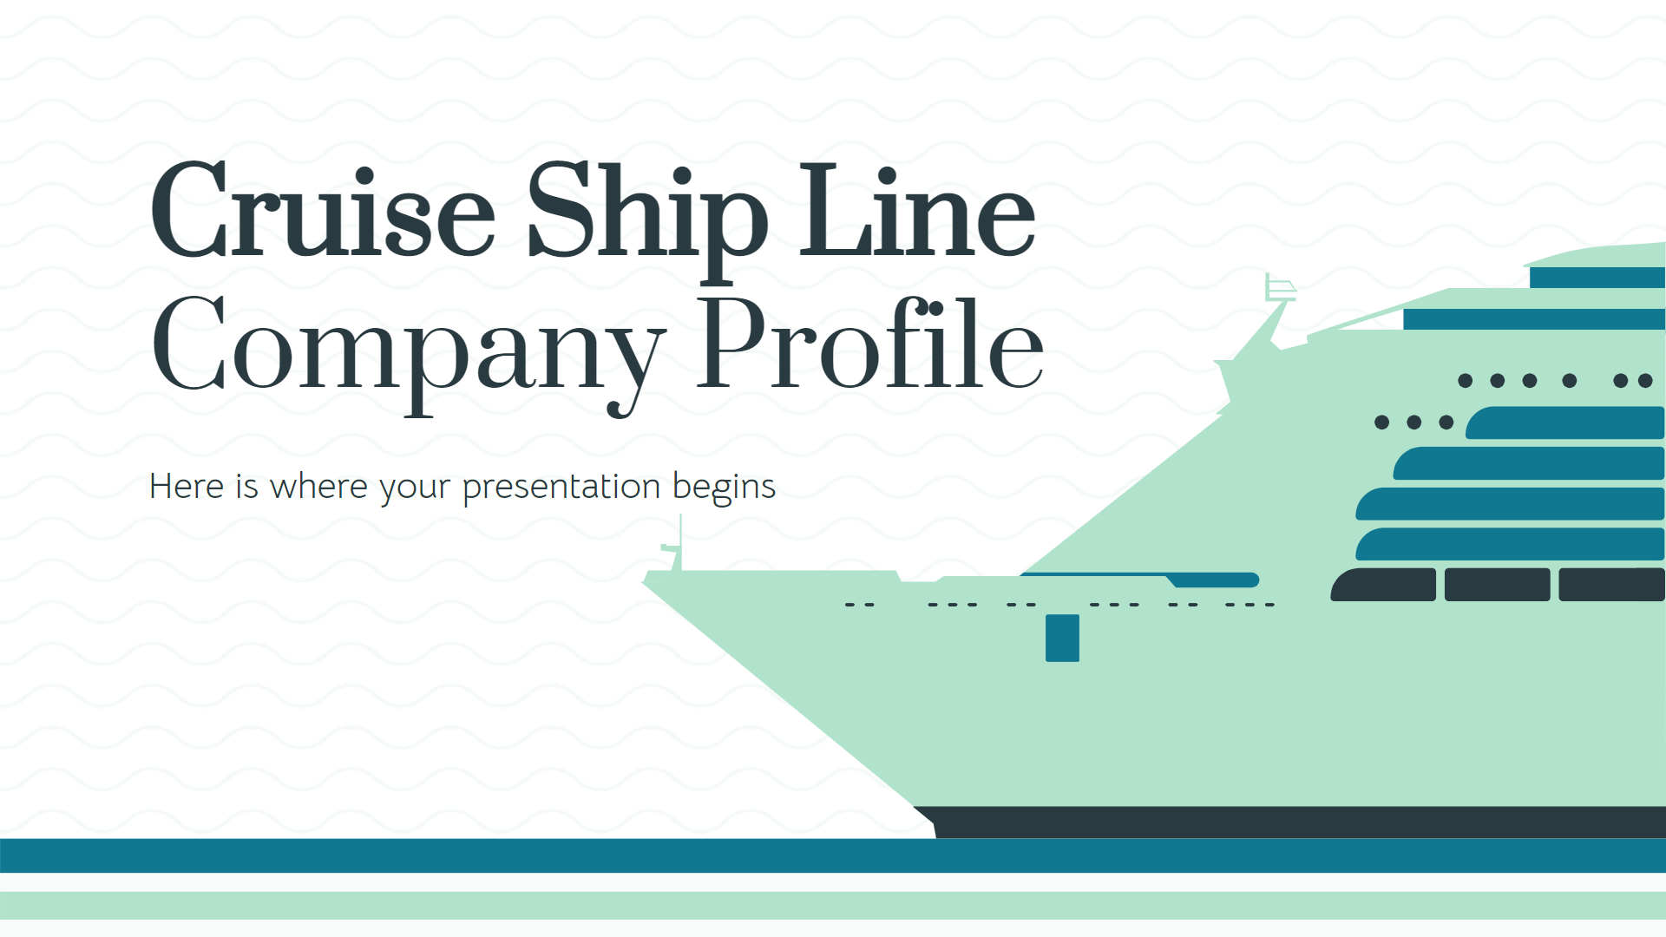

Links and Referal
TEAM
QUANTUM
SOFAR OCEANS :- https://www.sofarocean.com/
ONE OCEAN :- https://www.oneocean.com/
List of Ports in India Data( Source: Ministry of Shipping, India ) :- https://dwiep.ncscm.res.in/images/port.pdf
YOUTUBE :- https://youtu.be/aBEkINl2ed4?si=IerSkD_NygCcjlzt
ROUTING API ( SEA ROUTES) :- https://searoutes.com/routing-api/
OUR WEBSITE (UNDER DEVELOPMENT) :- https://quantum-csbs.github.io/OPI/
Ministry of ports, shipping, and waterways :- https://shipmin.gov.in/
Marine weather API :- https://open-meteo.com/en/docs/marine-weather-api

